Slide 1
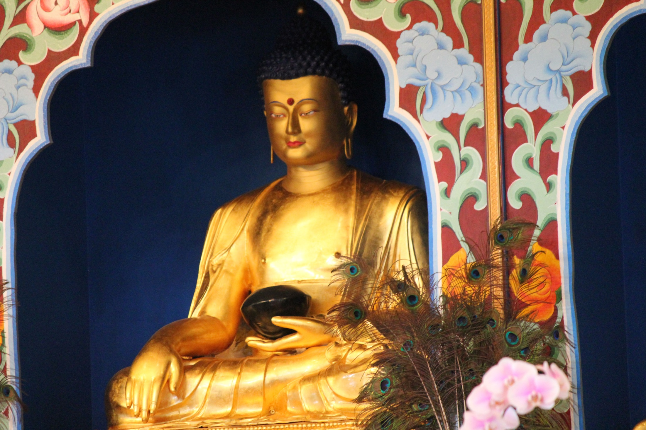
V

Slide 2
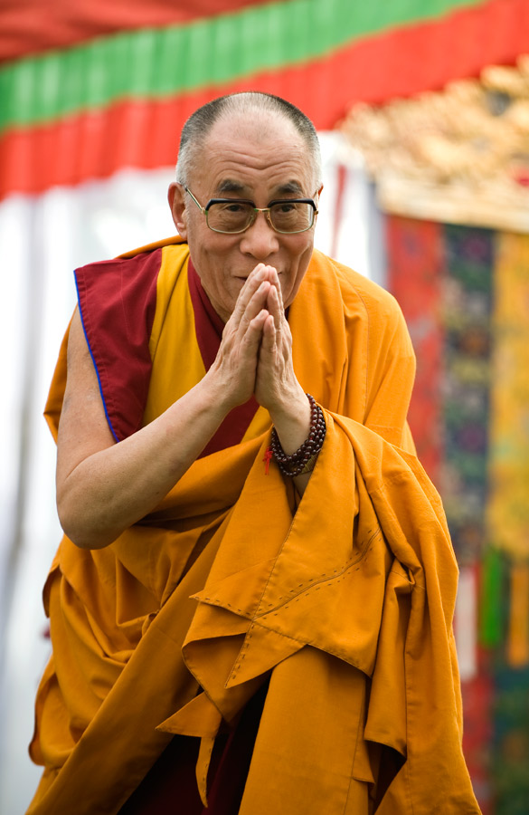
The most widely known Vajrayana Buddhist in Australia

Slide 3
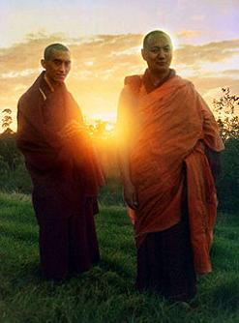
Vajrayana Buddhism comes to Australia in the 1970s

Slide 4
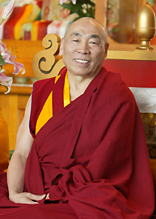
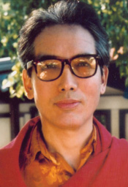
Vajrayana Buddhism is firmly established in Victoria in the 1980s

Slide 5
Four main schools
Each school is established at different historical periods and has slightly different emphases. Each school has its own head. The four main schools of Vajrayana Buddhism are:
Nyingma
Kagyu
Sakya
Gelug
Currently, the most widespread school in Australia is the Gelug School. His Holiness the 14th Dalai Lama is the head of the Gelug School and is considered the general spiritual head of the Tibetan people.

Slide 6
Origins of Vajrayana
It comes out of 5 centuries of Indian tradition and includes 14 centuries of history in Tibet
It presents as a more esoteric form of Buddhism reflecting the emergence of Tantric Buddhism in India during the 7th century.

Slide 7
Chenrezig: Buddha of Compassion

Slide 8
Symbolic meaning of Chenrezig (Avalokitesvara):
Representing the pure nature of all phenomena
For example Chenrezig’s
Colour white symbolises the capacity to dispel the darkness of the universe.
One head symbolises the oneness of absolute nature.
Four arms symbolise loving-kindness, compassion, rejoicing and equanimity.
Hands at the heart holding a jewel represents the Great Compassion – Bodhicitta … and so forth.

Slide 9
Essentialities
Vajrayana includes all three vehicles of Buddhism within the tradition (Theravarda, Mahayana and Vajrayana). For example:
You tame your mind-stream, provide benefit for others, And transform every appearance into the path of pure (nature)
Kunkhyen Longchen Rabjam

Slide 10
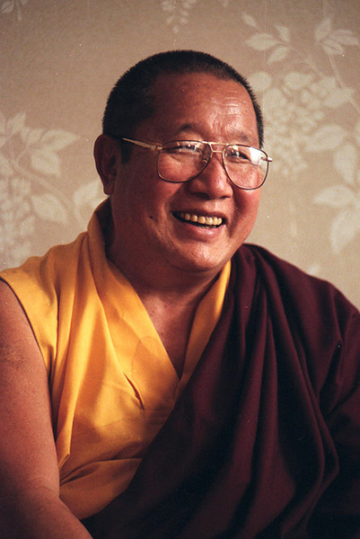
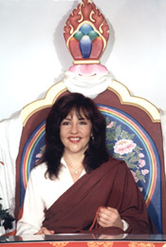
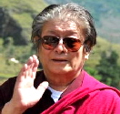
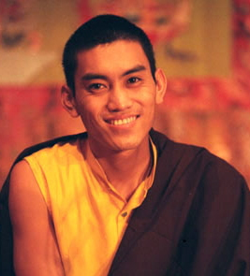
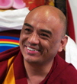
Monastic and non-Monastic teachers

Slide 11
The diversity of Vajrayana practitioners in Australia
Refugees especially from Tibet and/or via transferring countries such as Nepal and India
Migrants from the high altitude regions of the Himalayas and central Asian Plateaus including Bhutan, Nepal, Sikkim, Ladakh, India, Mongolia and parts of China
Australian born practitioners of various ethnic backgrounds including European, Asian and Indigenous backgrounds.

Slide 12
Cultural and Value Differences
Tibetan communality and indigeneity versus Western individuation.
Buddhists born into Buddhist families versus first generation Aussie Buddhists.
Challenges for second generation children of refugees and migrants.
The impacts for Tibetans coming from a diaspora community

Slide 13
Among our different circumstances compassion is the core
For as long as space endures, and for as long as living beings remains, until then, may I too abide to dispel the misery of the world.
  Shantideva, 8th century, Bodhicaryavatara

Slide 14
Sources
This presentation was created by Ani Tenzin Wangmo (Tenzin Bathgate) for the Victorian healthcare chaplains/pastoral carers attending the Buddhist Multi-faith day convened by the Buddhist Council of Victoria with the support of the HealthCare Chaplaincy Council of Victoria , May 3rd, 2014.
Cover Photo: Shakyamuni Buddha, Palyul Ling Retreat Centre, McDonough, NY, USA Smug Mug Album www.palyulproductions.org
Photo His Holiness the 14th Dalai Lama http://www.dalailama.com/gallery/album/4/50#ad-image-1 from the official website of HH Dalai Lama.
Photo of Lama Zopa Rinpoche and Lama Thubten Yeshe Rinpoche from the Australian website for the Foundation of the Preservation of the Mahayana Tradition (FPMT) http://www.fpmta.org.au/
Photo of Traleg Rinpoche 1955-2012 http://www.evam.org/about_director.shtml and Venerable Geshe Doga 1935- http://www.tarainstitute.org.au/teachers/15-resident-lama
Photo of Thangka of Chenrezig, Buddha of Compassion, Palyul Productions Smug Mug Album, http://palyulmedia.smugmug.com/Deities-1/Peaceful-Deities/i-xZffqr4
Dilgo Khyentse. The Heart Treasure of the Enlightened Ones. Foreword by the HH Dalai Lama. Shambala 1992.
Reginald Ray Indestructible Truth and Secret of the Vajra World, Shambala Press, 2002,respectively.
Photos by L-R by row - HH Penor Rinpoche, Jetsunma Ahkon Lhamo Rinpoche, Dungse Thinley Norbu Rinpoche, HE Mugsang Tulku Rinpoche and Khenpo Tenzin Norgey. Source: Palyul Productions http://palyulproductions.org/html/teachers.html

